Slide 1
NLP Basic Distributed Representation

Slide 2
CONTENT
Distributed Representation
Word2Vec
CBOW - Training

Slide 3



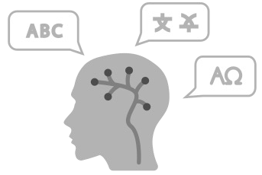




1 – Distributed Representation
Text Representation
Natural Language Understanding (NLU)
I go to school
Natural Language Generation (NLG)
a computer’s ability to understand language
generate natural language by a computer
Convert
Syntax
Semantics
Phonology
Pragmatics
Morphology
[0 0 0 0 1 0 1 0 1 ]

Slide 4
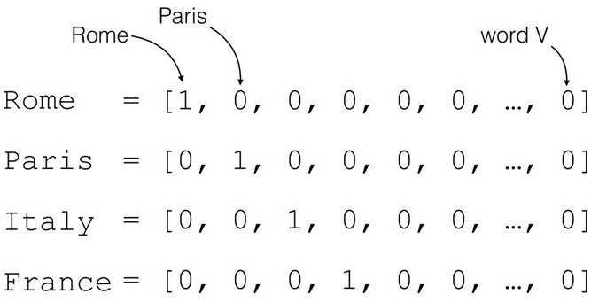
1 – Distributed Representation
Review: Basic Representation
One-hot encoding, BOW, TF-IDF
Sparse Representation
Not capture the meaning
OOV Problem

Slide 5





1 – Distributed Representation
Distributional Similarity: meaning of a word defined by context
Mùa xuân là tết trồng cây
Làm cho đất nước càng ngày càng xuân
Distributional Hypothesis: similar context => similar meaning
Hai cha con bước đi trên cát Hai bố con bước đi trên cát

Slide 6
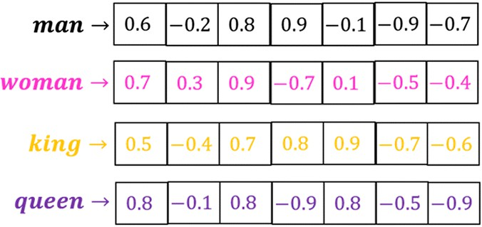
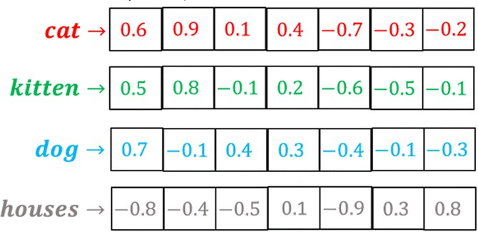
1 – Distributed Representation
Distributional Representation: dense vectors (low dimensional, hardly any zeros)
Embedding: map words into a distributed representation space
Vector Semantics: based on distributional properties of words in a large corpus

Slide 7
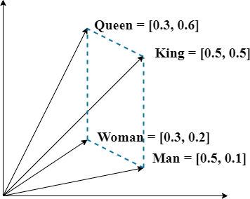
1 – Distributed Representation
Based on neural network: Word2Vec, Glove, Fasttext,…
Word2Vec: embedding dimension (50 – 100)
Capture word analogy relationships

Slide 8
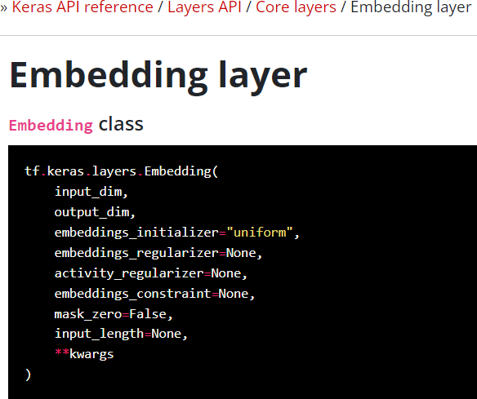
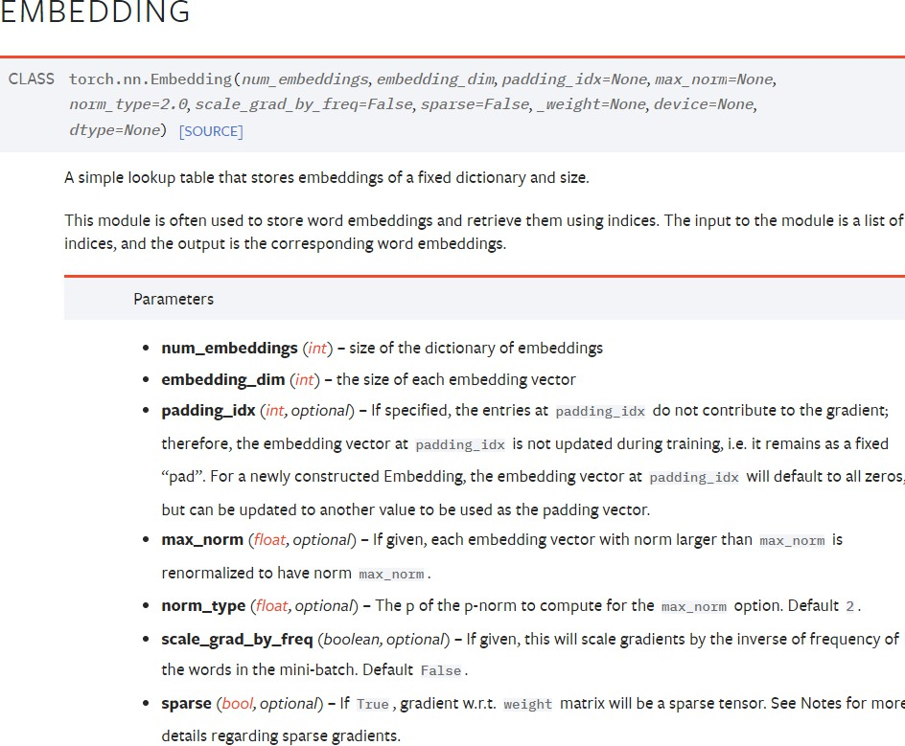
1 – Distributed Representation
Embedding Layer

Slide 9



1 – Distributed Representation
Embedding Layer
Embedding matrix
Input matrix
Index-based Representation
0 4 2 3 1
5 6 1 2 3
Input shape: 2x5
0 | 0.1 | 3.1
1 | 0.5 | 2.5
2 | 1.3 | 0.6
3 | 0.4 | 0.1
4 | 0.7 | 1.4
5 | 2.3 | 1.7
6 | 2.5 | 2.5
Vocab size = 7

Slide 10




1 – Distributed Representation
Embedding Layer
Embedding matrix
Input matrix
Index-based Representation
0 | 0.1 | 3.1
1 | 0.5 | 2.5
2 | 1.3 | 0.6
3 | 0.4 | 0.1
4 | 0.7 | 1.4
5 | 2.3 | 1.7
6 | 2.5 | 2.5
w[0]
w[5]
w[4]
w[6]
w[2] w[3]
w[1] w[2]
w[1]
w[3]
Select Operation
0 4 2 3 1
5 6 1 2 3
Input shape: 2x5
Vocab size = 7

Slide 11



1 – Distributed Representation
Embedding Layer
Embedding matrix
Input matrix
Index-based Representation
0 | 0.1 | 3.1
1 | 0.5 | 2.5
2 | 1.3 | 0.6
3 | 0.4 | 0.1
4 | 0.7 | 1.4
5 | 2.3 | 1.7
6 | 2.5 | 2.5
w[0]
w[5]
w[4]
w[6]
w[2] w[3]
w[1] w[2]
w[1]
w[3]
Select Operation
0 4 2 3 1
5 6 1 2 3
Output matrix
Input shape: 2x5
 | 3.1 | 1.4 | 0.6 | 0.1 | 2.5
0.1 | 0.7 | 1.3 | 0.4 | 0.5
2.3 | 2.5 | 0.5 | 1.3 | 0.4
Vocab size = 7
Input shape: 2x5x2

Slide 12
2 – Word2Vec
Paper - Word2Vec:
  2 algorithms:
Continuous bag-of-words (CBOW) Skip-gram
  2 training methods:
Negative Sampling Hierarchical SoftMax

Slide 13
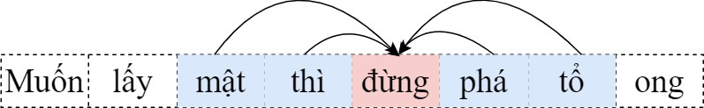
2 – Word2Vec
Word2Vec: CBOW
Predict a center word from the surrounding context in term of word vectors
Example: “Muốn lấy mật thì đừng phá tổ ong” “đừng”: a central target word
“mật”, “thì”, “phá”, “tổ”: a context window size = 2

Slide 14
2 – Word2Vec
Word2Vec: CBOW
CBOW model: concerned with the conditional probability of generating the target word “đừng” based on the context words “mật”, “thì”, “phá”, “tổ”
P(đừng|mật, thì, phá, tổ)

Slide 15
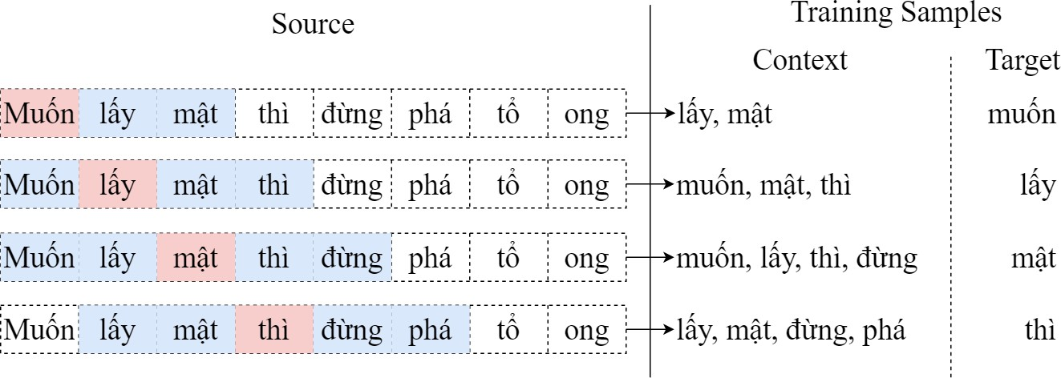
2 – Word2Vec
Word2Vec: CBOW
Example: “Muốn lấy mật thì đừng phá tổ ong”

Slide 16
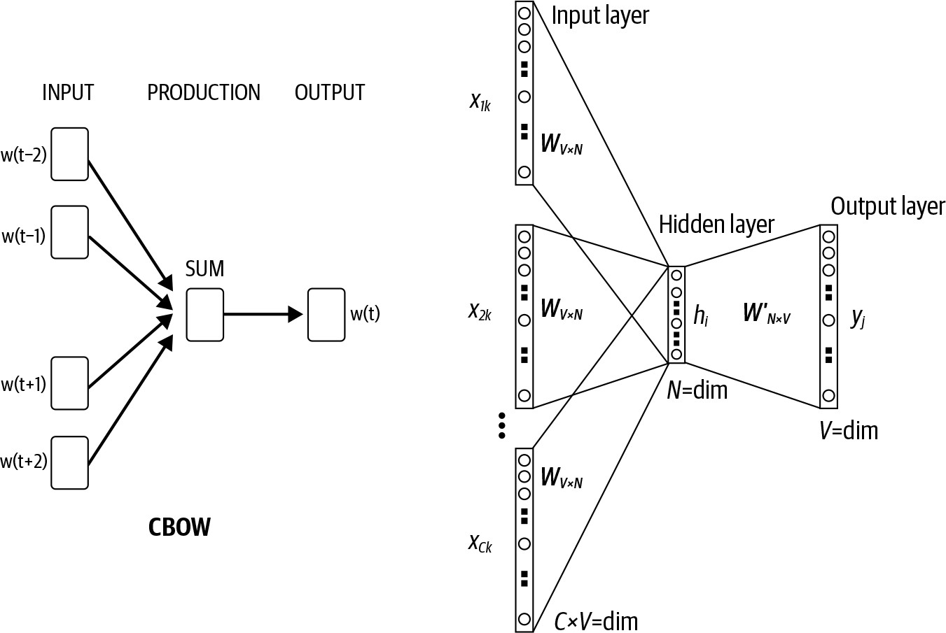
2 – Word2Vec
Word2Vec: CBOW

Slide 17
2 – Word2Vec
Word2Vec: CBOW
w_{i}: word i from vocabulary V
each word w_{i} is represented as two d-dimension vectors:
  𝑣_{𝑖} ∈ ℝ^{𝑑}: the context word vector
  𝑢_{𝑖} ∈ ℝ^{𝑑}: the central target word vector

Slide 18
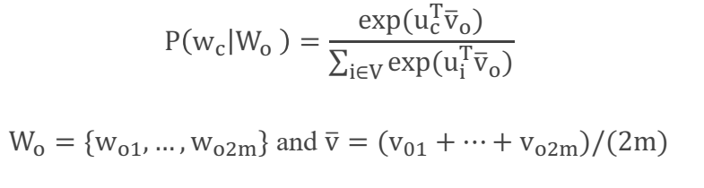
2 – Word2Vec
Word2Vec: CBOW
w_{c}: central target word, indexed as c
w_{o1},…,w_{o2m}: context words, indexed as o₁,…, o_{2m} in the vocabulary with m: window size
The conditional probability:

Slide 19
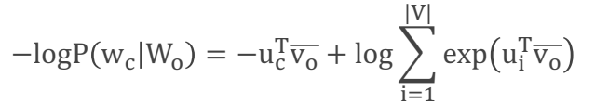
2 – Word2Vec
Word2Vec: CBOW
CBOW Model Training
Optimization objective function:
Use SGD to update all relevant word vectors v and u
NOTE: CBOW model use the context word vector as the representation vector for a word

Slide 20
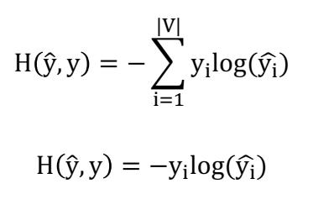
2 – Word2Vec
Word2Vec: CBOW
Cross entropy
Loss function:
If y is a one-hot vector:

Slide 21
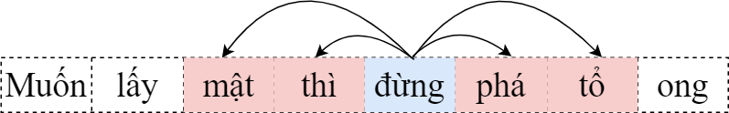
2 – Word2Vec
Word2Vec: Skip-gram
Predict the distribution (probability) of context words from a center word
Example: “Muốn lấy mật thì đừng phá tổ ong” “đừng”: a central target word
“mật”, “thì”, “phá”, “tổ”: a context window size of

Slide 22

2 – Word2Vec
Word2Vec: Skip-gram
Skip-gram model: The conditional probability for generating the context words “mật”, “thì”, “phá”, “tổ” based on the central word “đừng”
Assume: the context words are generated independently:

Slide 23
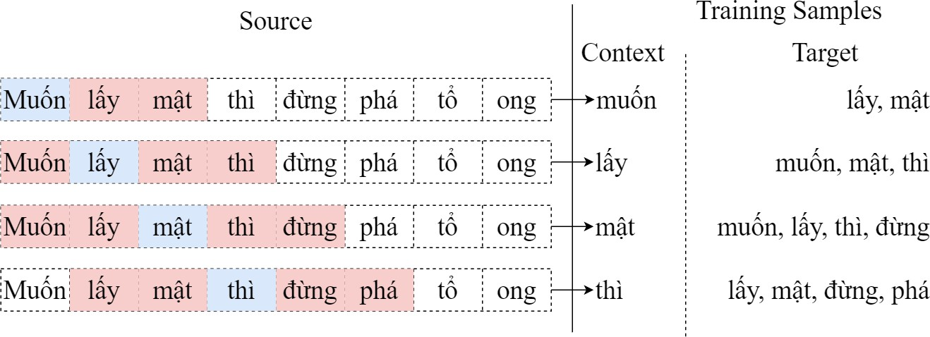
2 – Word2Vec
Word2Vec: Skip-gram
Example: “Muốn lấy mật thì đừng phá tổ ong”

Slide 24
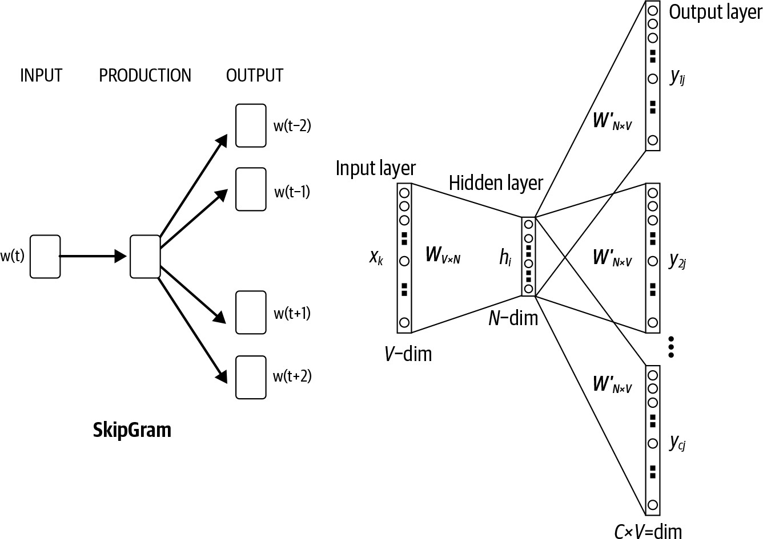
2 – Word2Vec
Word2Vec: Skip-gram

Slide 25
2 – Word2Vec
Word2Vec: Skip-gram
w_{i}: word i from vocabulary V
each word w_{i} is represented as two d-dimension vectors:
  𝑣_{𝑖} ∈ ℝ^{𝑑}: the central target word
  𝑢_{𝑖} ∈ ℝ^{𝑑}: the context words

Slide 26
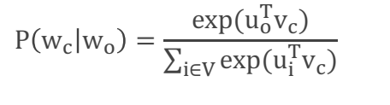
2 – Word2Vec
Word2Vec: Skip-gram
w_{c}: central target word, indexed as c in the dictionary
w_{o}: context word, indexed as o in the dictionary
The conditional probability:

Slide 27
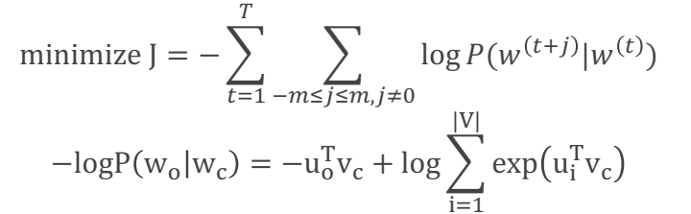
2 – Word2Vec
Word2Vec: Skip-gram
Optimization objective function:
Use SGD to update all relevant word vectors v and u
NOTE: Skip-gram model use the central target word vector as the representation vector for a word

Slide 28



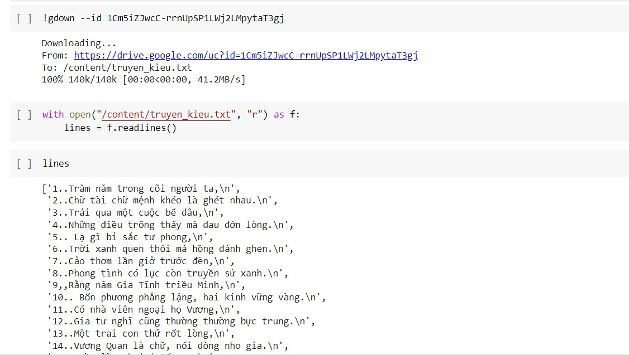




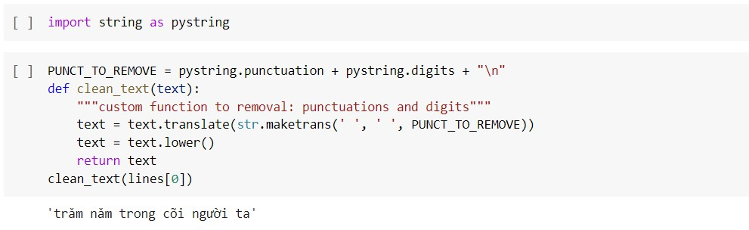








3 – CBOW Training
1. Load Dataset
Truyện Kiều - Nguyễn Du
2. Preprocessing
3. Build Data
4. Representation
5. CBOW Model
6. Predict

Slide 29

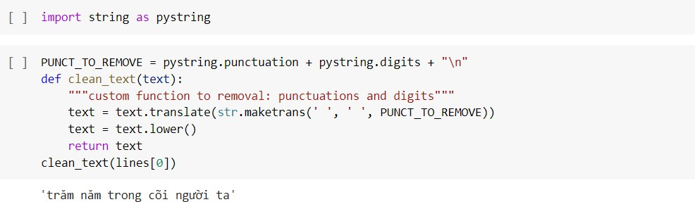
3 – CBOW Training
1. Load Dataset
Removal punctuation, digits, tab,…
Lowercasing
2. Preprocessing
3. Build Data
4. Representation
5. CBOW Model
6. Predict

Slide 30
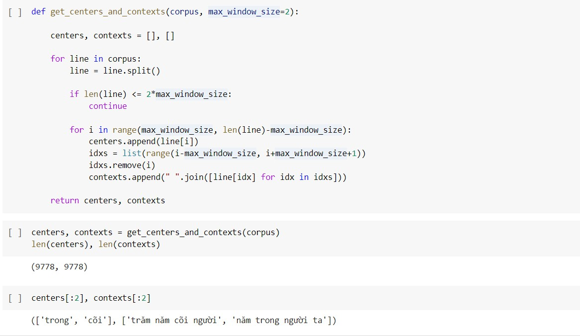
3 – CBOW Training
1. Load Dataset
Get centers and contexts
2. Preprocessing
3. Build Data
4. Representation
5. CBOW Model
6. Predict

Slide 31
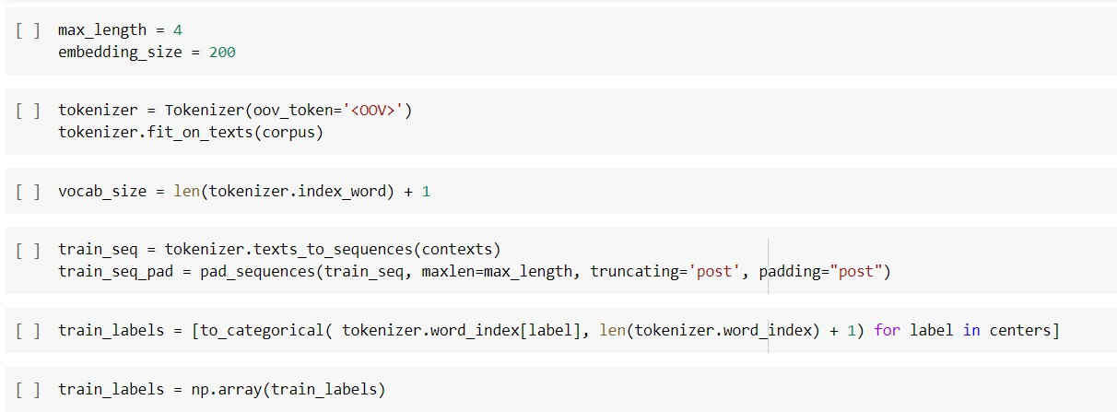
3 – CBOW Training
1. Load Dataset
Convert text into feature
2. Preprocessing
3. Build Data
4. Representation
5. CBOW Model
6. Predict

Slide 32
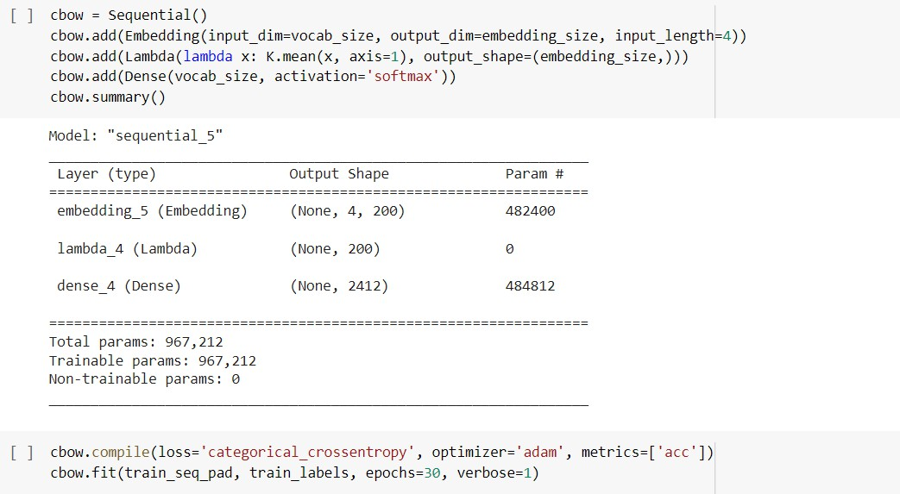
3 – CBOW Training
1. Load Dataset
2. Preprocessing
3. Build Data
4. Representation
5. CBOW Model
6. Predict

Slide 33
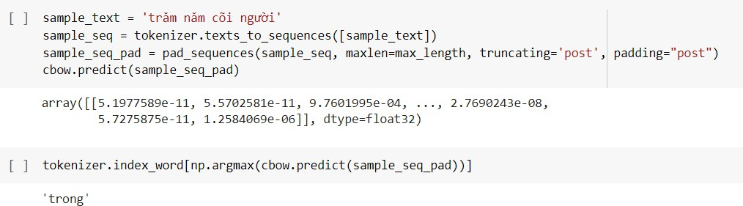

3 – CBOW Training
1. Load Dataset
Predict Center Word from Context
2. Preprocessing
3. Build Data
4. Representation
5. CBOW Model
6. Predict

